Slide 1
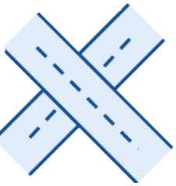
Optimal Control for Connected and Autonomous Vehicles at Signal-Free Intersections
Team 3:
Michel Yakoub
Paula Fahmy
Amr Abdrabo
Youssef Abdelhady
Bishoy Essam

Slide 2
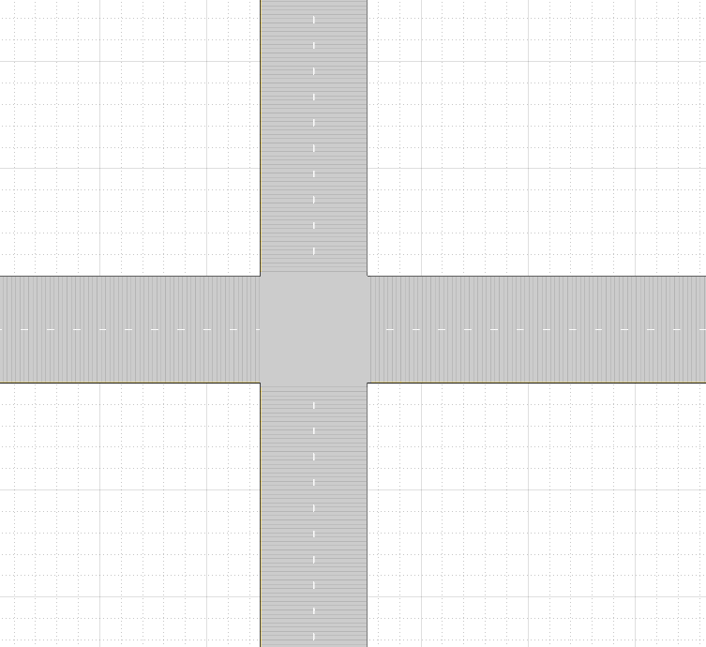
Our Problem

Slide 3
Our Problem

Slide 4
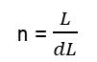
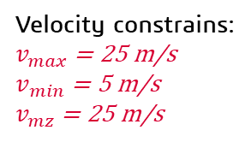
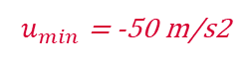
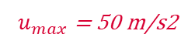
Our Problem
u (acc) is our decision variable
u
Velocity constrains:
$v_{max}$= 25 m/s
$v_{min}$= 5 m/s
$v_{mz}$= 25 m/s
$u_{max}$ = 50 m/s2
$u_{min}$ = -50 m/s2
…
n
n-1
n-2
n-3
3
2
1
0
n = $\frac{L}{dL}$
MZ
…
CZ
S = 50 m
L = 300 m
dL = 5 m

Slide 5
Two Objective Functions
1
2
Travel Time
Fuel Consumption
Total travel time of all the vehicles
Total fuel consumption of all the vehicles

Slide 6
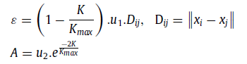
Our new algorithm: Pathfinder algorithm (PFA)
Leader
Leader
Leader
In time t=T
After Δt1 time
After Δt2 time
Exploration & Exploitation

Slide 7
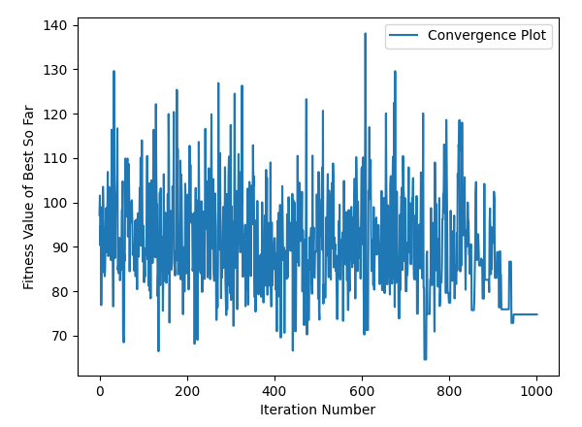
Results for 1000 iterations
SA Best fitness: 76.2
In iteration: 950

Slide 8
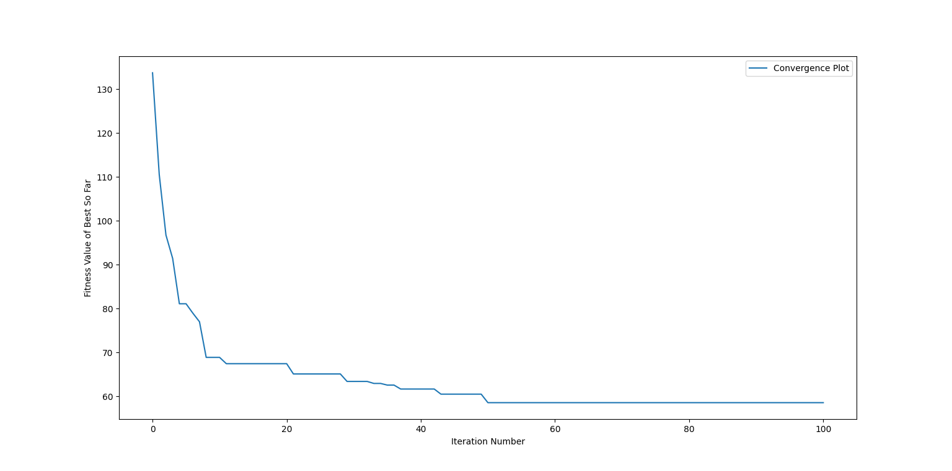
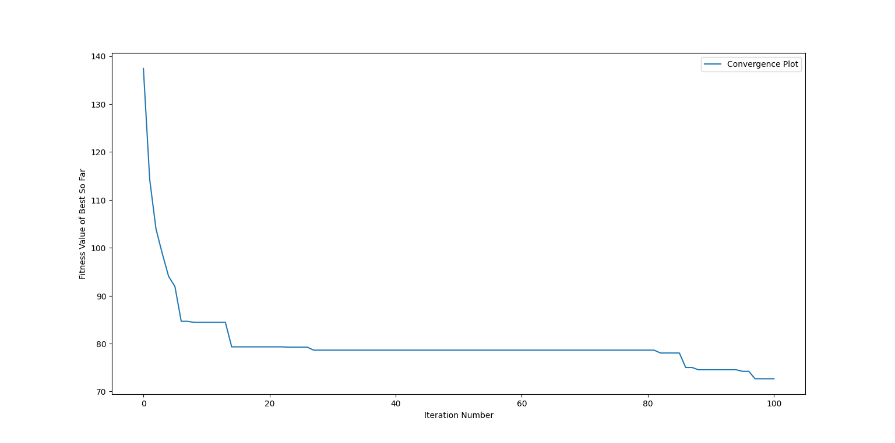
Results for 100 iterations
GA Best fitness: 57.88
In Iteration: 50
PSO Best fitness: 71.3
In iteration: 95

Slide 9
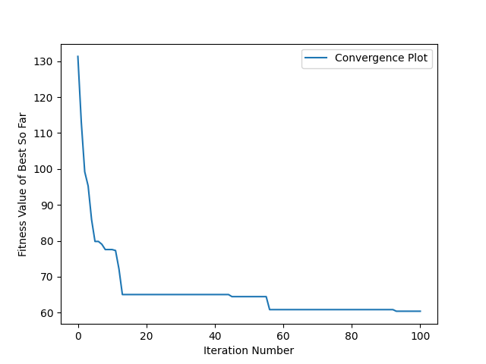
Results for 100 iterations
PFA Best fitness: 60.41
In Iteration: 95

Slide 10
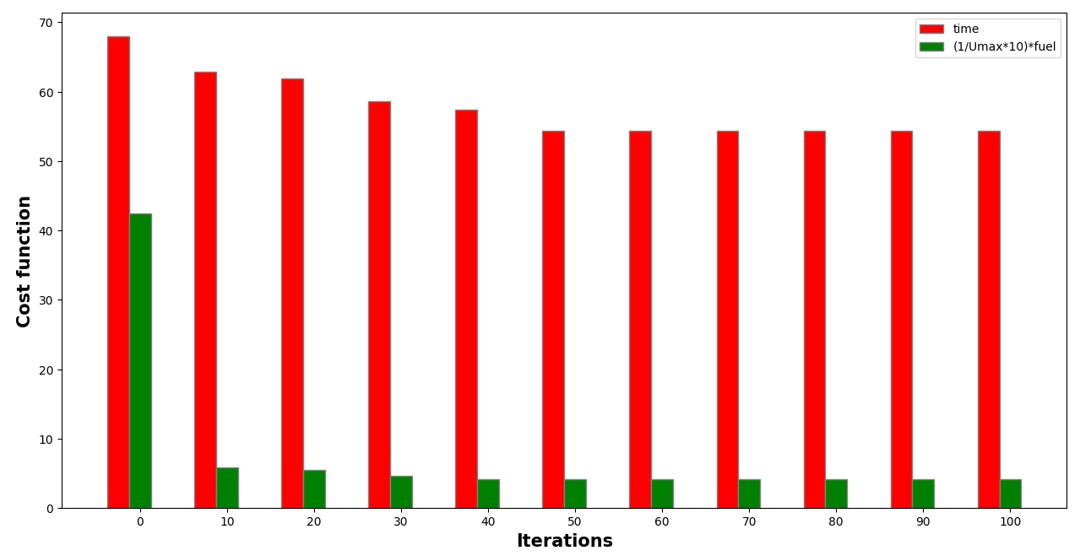
Fuel vs Time
GA

Slide 11
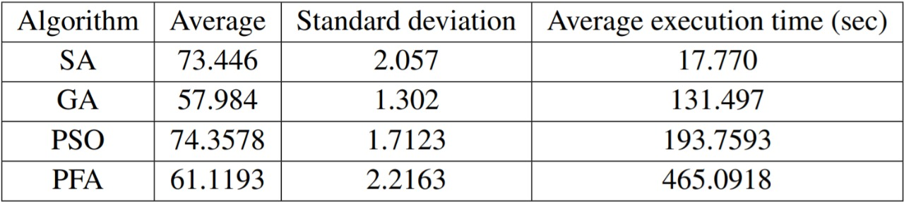
KPIs for 10 runs

Slide 12
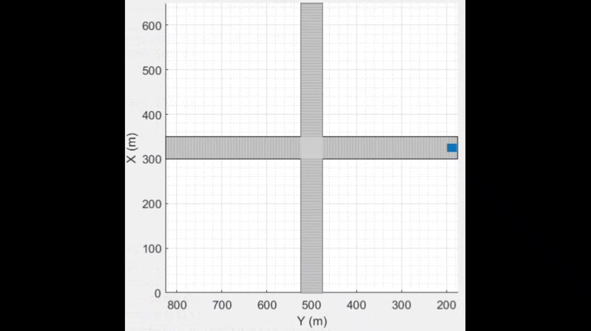
Visualization
4 cars:
CAV(0, "EW")
CAV(10, "EW")
CAV(15, "NS")
CAV(20, "NS")
Arrival time to CZ
Direction

Slide 13
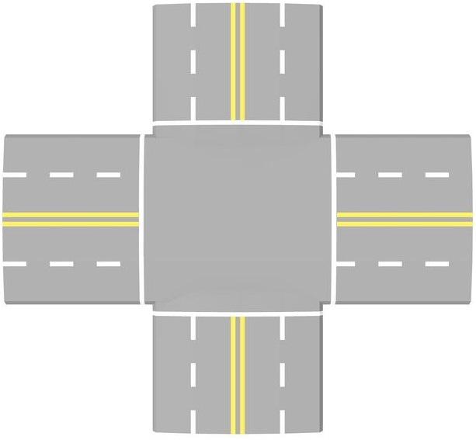
Thank You :)

